Slide 1
Logistic regression
2 slides

Slide 2
Left part
Logistic Regression - Dichotomous Response variable and numeric and categorical explanatory variables
Response - Presence/Absence of characteristic
Predictor - Numeric variable observed for each case
Model - π(x) ≡ Probability of presence at predictor level x
Odds Ratio
Interpretation of Regression Coefficient (β):
In linear regression, the slope coefficient is the change in the mean response as x increases by 1 unit
In logistic regression, we can show that:
Thus e^{β} represents the change in the odds of the outcome (multiplicatively) by increasing x by 1 unit

Slide 3
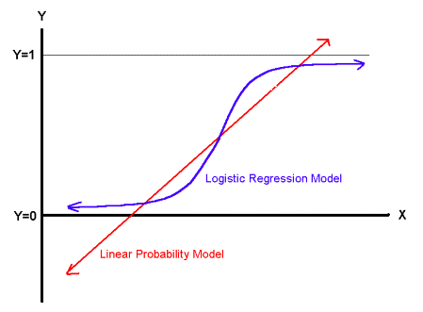
Right part
The "logit" model: ln[p/(1-p)] = β₀ + β₁X
p is the probability that the event Y occurs, p(Y=1)
[range=0 to 1]
p/(1-p) is the "odds ratio"
[range=0 to ∞]
ln[p/(1-p)]: log odds ratio, or "logit“
[range=-∞ to +∞]
if you let β₀ + β₁X =0, then p = .50
as β₀ + β₁X gets really big, p approaches 1
as β₀ + β₁X gets really small, p approaches 0

